Slide 1
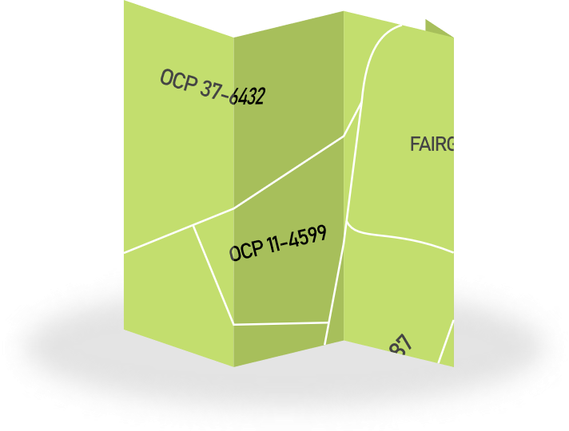
So You Want
to be a pco?
So You Want
to be a pco?
May 2022
1. FIND YOUR PRECINCT
PCO means “Precinct committee officer”
you’d be the most grassroots official in your party – in charge of organizing Your neighborhood!
First find your precinct! Visit 11thLDdems.org/Find-my-precinct
2. Register online
Becoming a pco means becoming an elected offical
to get elected, you’ve got to file – which means registering your “candidacy”
there is one special week to file: may 16, 2022 – may 20, 2022
file then at kingcounty.gov/depts/elections
3. Get elected
if no one else in your precinct signs up, you’ll automatically become pco!
if someone else signs up in your precinct, you’ll get your name on the ballot!
if you win – you’re a pco!
if you lose – don’t worry, you can still get appointed to serve as pco in a vacant precinct
4. Lead your community to a better future!
Want to Learn More?
facebook.com/11thLDdems
Follow the 11th LD Dems!
@11thLDdems
@11thLDdems
www.11thLDdems.org

